Slide 1

GHANA CIVIL AVIATION AUTHORITY
SAFETY AND SECURITY, OUR PRIORITY

Slide 2
About the Author
Christian Nii Commey Solomon
Final Year Student at Ghana Communication Technology University
BSc. Computer Engineering

Slide 3

Table of contents
01
02
03
04
05
Introduction to CA
GCAA
Within GCAA
History, Global & National Context
History, Functions
Support, Safety Regulators, ANSP
ANSP
AIS
ATC, AIS, ATSE
Doc&Pub, NOF, Flight Planning and Crew Briefing

Slide 4

01
Introduction

Slide 5

Civil Aviation
non-military and non-governmental; private and commercial flights.
plays a pivotal role in connecting people, goods, and services.
governed by international standards and national regulations, civil aviation comprises various sectors, from commercial air transport to aerial work and general aviation.
this sector fosters global connectivity , economic growth; prioritizing safety and efficiency in the skies.

Slide 6
History
Post-War Aviation
1944
commercial aviation grows, forcing manufacturers to adapt to the production of passenger aircrafts
the need for regulation and safety standards; collaboration from individual stakeholders.
- 1944
The Chicago Convention on International Civil Aviation was signed by 52 states.
to set forth the purpose of standardising the use of airspace for safety, efficiency and regularity of air transport

Slide 7
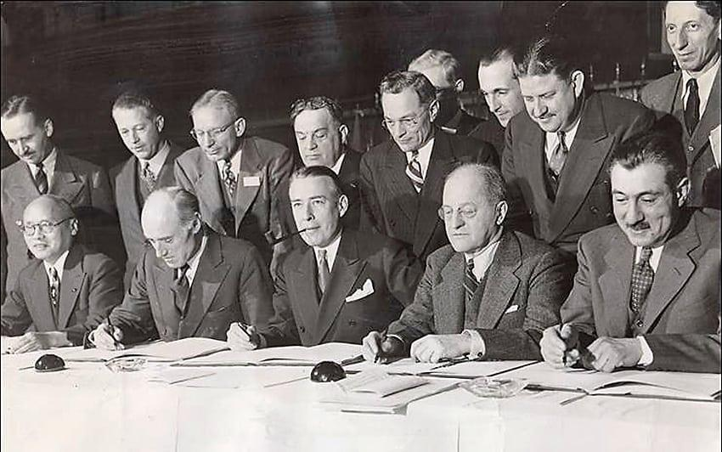
History
1944
by overseeing:
Personnel Licensing - regulating the basic training and issuance of licenses and certificates.
Flight Operations - carrying out safety oversight of commercial operators.
Airworthiness - issuing certificates of registration and certificates of airworthiness to civil aircraft, and overseeing the safety of aircraft maintenance organizations.
Aerodromes - designing and constructing aerodrome facilities.
Air traffic services - managing the traffic inside of a country's airspace.

Slide 8
History
March 2019
October 1947
As of , the Chicago Convention had 193 state parties, which includes all member states of the United Nations except Liechtenstein; and 36 Council member states including Ghana.
The convention is supported by nineteen annexes containing standards and recommended practices (SARPs).
The ICAO became a specialised agency of the UN and it was charged with coordinating international air travel.

Slide 9

Global vs National
GCAA
ICAO
The Ghana Civil Aviation Act 2004, Act 678 establishes Ghana Civil Aviation Authority, among other things, to:
Provide Air Navigation Services (Air Space Management)
License and Certify Flight Operators, Airports, etc. (Safety Regulation)
specialised agency of the UN coordinating international air travel.
193 state parties - includes all member states of the United Nations; 36 Council member States
The convention is supported by annexes containing standards and recommended practices (SARPs)

Slide 10
02
GCAA

Slide 11
Ghana Civil Aviation Authority
regulatory agency of Ghana for air transportation
provides air navigation services ; Accra Flight Information Region
(FIR), comprises the airspace over the Republic of Ghana and a large area over the Atlantic Ocean in the Gulf of Guinea.

Slide 12
History
PWD
Act 678
The GCAA was established in 1930 as a unit with Public Works Department (PWD)
-1986 that it became an Authority under the PNDC Law 151.
2004, The Civil Aviation Act, allows establishment of a Civil Aviation Authority which will focus on the core functions of Airspace management and Safety Regulations whilst allowing for a different organization to handle Airport development and operations.

Slide 13
History
2007
Pursuant to the above, the GCAA was restructured into two bodies, that is, the new Ghana Civil Aviation Authority (GCAA) and the Ghana Airports Company Limited (GACL) on 1st January, 2007.

Slide 14
GCAA vs GACL
GACL
GCAA
Airport development and operations.
Provide Air Navigation Services (Air Space Management)
License and Certify Flight Operators, Airports, etc. (Safety Regulation)

Slide 15
Functions
Functions of GCAA under ACT 678
Licensing and Certification of Air Transport Operators
Licensing and Certification of Aerodromes and the Construction, Operation, Maintenance and Managements of Navigation Sites.
Provision of Air Navigation Services (Air Space Management) within the Accra Flight Information Region (FIR).
Regulation of Air Transport Services.
Promoting the Development of Civil Air Transport Industry in Ghana.
Advising Government on all matters Concerning Civil Aviation
Provision of oversight for all activities related to civil aviation.

Slide 16
03
Within GCAA

Slide 17
Our main components
Safety Regulator (SRD)
Air Navigation Services Provision (ANSP)
CASA - overseeing and regulating Civil Aviation Safety
Safety Oversight Department
Accident Investigation Bureau
ATC - prevent collisions; constant communication
AIS - AIP, NOTAM, Flight Planning & Crew Briefing
ATSE - maintenance ; all ground based equipment
Support
Human Resource
Finance
Legal Affairs
ICT

Slide 18
04
ANSP

Slide 19
Our main components
ATC
AIS
Ensures the safe and efficient movement of air traffic within controlled airspace.
prevent collisions;
constant communication
AIP
NOTAM
Flight Planning & Crew Briefing
Overflight & Landing ( added responsibility ; 24hrs)
ATSE
maintenance ; all ground based equipment

Slide 20
05
AIS

Slide 21
Aeronautical Information Services
The objective of the aeronautical information service (AIS) is to ensure the flow of aeronautical data and aeronautical information necessary for global air traffic management (ATM) system safety, regularity, economy and efficiency in an environmentally sustainable manner

Slide 22
Functions
receive, assemble, edit, format, publish/store and distribute aeronautical data and aeronautical information concerning the Accra Flight Information Region (FIR).
Where 24-hour service is not provided, service shall be available during the whole period an aircraft is in flight in the area of responsibility of AIS.
obtain aeronautical data and aeronautical information to enable it to provide pre-flight information service and to meet the need for in-flight information:
from the AIS of other States
from other sources that may be available.
ensure that aeronautical data and aeronautical information necessary for the safety, regularity or efficiency of air navigation are made available in a form suitable for the operational requirements of the air traffic management (ATM) community, including:
those involved in flight operations, including flight crews, flight planning and flight simulators; and
the air traffic services unit responsible for flight information service and the services responsible for pre-flight information.

Slide 23
Scope
The scope of aeronautical data and aeronautical information include the following sub-domains;
national regulations, rules and procedures
aerodromes and heliports
airspace
ATS routes
flight procedures
radio navigation aids/ systems
obstacles
geographic information

Slide 24
Departments
Doc & Pub
NOTAM & AEROCOM
Flight Planning & Crew Briefing

Slide 25
Doc & Pub
The Documentation & Publication Office in AIS is responsible for the publication of the following Aeronautical Information Products;
Aeronautical Information Publication ( AIP ); including Amendments ( AIP AMDT ) and Supplements ( AIP SUP )
Aeronautical Information Circulars (AIC)
Aeronautical Charts

Slide 26
AIP
Amendment Service to the AIP
The AIP Amendment ( AIP AMDT ) incorporates permanent changes / operationally significant permanent changes into the AIP on the indicated publication date or AIRAC effective date.
Supplement to the AIP
The AIP Supplement ( AIP SUP ), incorporates temporary changes to the information contained in the AIP which requires advance distribution.
a publication issued by or with the authority of a state; containing Aeronautical Information of a lasting character essential to Air Navigation.
AIP Ghana is Published in one Volume
The AIP is published in a loose-leaf form in english only; for use in international and domestic operations and applies to commercial and private flights.

Slide 27
AIC
a notice containing information that does not qualify for the origination of a NOTAM or for the inclusion in the AIP;
contains information on the long term forecasts of any major change in legislation, regulations, procedures or facilities;

Slide 28
Aeronautical Charts
Aeronautical charts are a visual representation of a portion of the earth specifically designed to meet the needs of air navigation.

Slide 29
AIRAC
In our publication, we use a system called AIRAC ( Aeronautical Information Regulation and Control ) - which signifies a system aimed at advance notification, based on common effective dates of circumstances that necessitate signficant changes in operating practices
AIRAC information will be issued such that the information will be received by the user no later than 28 days and for major changes, no later than 56 days before the effective date.

Slide 30
NOTAM
They are distributed by means of telecommunication by the International NOTAM Office on two series;
Series A NOTAM starts from 0001 and cover the following information: General rules, en-route navigation and communication facilities, airspace restrictions, and information concerning major international aerodromes within the Accra FIR
Series B NOTAM starts from 0001 and cover information of concern to aircraft other than those engaged in international civil aviation
NOTAM ( Notice To Airmen )are short, time-critical notices that provide immediate information about changes, conditions, or hazards that could affect flight safety and operations
The NOF in AIS is responsible for issuing of NOTAMs as required, providing timely and accurate information about changes or potential hazards to aviation; such include;
airport closures
runway status
navigation aids
other critical data
NOTAMs generally have a validity of 90 days

Slide 31
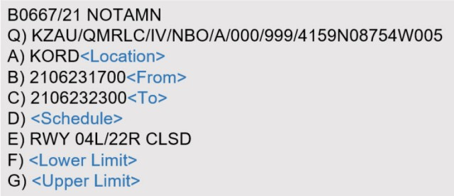

Slide 32

Thank You

